Slide 1
SOFE 4820U — Modelling & Simulation
Stock Market Risk &
Strategy Simulation
Monte Carlo Simulation for Investment Decision Support
Shivam Patel · Saumya Pandya · Rushi Rathod

Slide 2



Problem Statement
Unpredictable Markets
Exact Prediction is Hard
Investors Lack Risk Tools
Stock markets are inherently volatile and driven by countless external factors, making straightforward price prediction nearly impossible with traditional methods.
Complex, non-linear market dynamics mean that simple forecasting models consistently fail — especially in volatile or crisis-driven conditions.
Retail investors have limited access to data-driven risk analysis tools, forcing them to rely on intuition rather than probabilistic evidence.

Slide 3
Why Simulation?
$500B+
Lost annually to poor investment decisions worldwide
Simulation lets us:
Quantify uncertainty instead of ignoring it
87%
Of retail investors underperform the benchmark index
Stress-test investment strategies across thousands of scenarios
Understand worst-case outcomes before committing capital
1,000×
More scenarios tested vs. manual analysis
Compare strategy risk-return trade-offs objectively

Slide 4
Related Work
Time Series
Models
Moving
Averages
Monte Carlo
Methods
ARIMA · GARCH
SMA · EMA
Stochastic Simulation
Statistical models that capture temporal dependencies and volatility clustering in price data.
Smoothing techniques that reduce noise and identify trends by averaging prices over rolling windows.
Random sampling at scale to model price paths and generate probability distributions of future outcomes.
Limited to linear trends; breaks down in turbulent markets.
Lagging indicator — misses sudden directional changes.
Our chosen approach — extends prior work with strategy evaluation.

Slide 5
Proposed Solution
Monte Carlo Simulation — Four pillars of the approach
1,000
252
4
3
Simulated Paths
Trading Days
Stocks Supported
Strategies Tested
per stock scenario
one full market year
AAPL · TSLA · MSFT · AMZN
B&H · Moving Avg · Stop Loss

Slide 6
System Overview
1
2
3
4
Select Stock
Fetch Data
Compute Stats
Run Simulation
AAPL · TSLA
MSFT · AMZN
Yahoo Finance
Historical prices
Mean return μ
Volatility σ
1,000 paths
252 trading days
Outputs · Strategy performance metrics · Average profit/loss · Worst-case scenario · Risk-return trade-off

Slide 7
Technical Model
Discrete-time Geometric Brownian Motion approximation
P(t+1) = P(t) × (1 + rᵣₐₙᵈₜᵒᵐ)
P(t)
P(t+1)
Current price — today's closing price used as the simulation base
Next price — the simulated price for the following trading day
μ (mu)
σ (sigma)
Mean daily log-return computed from Yahoo Finance historical data
Std. deviation of daily returns — captures observed market volatility

Slide 8
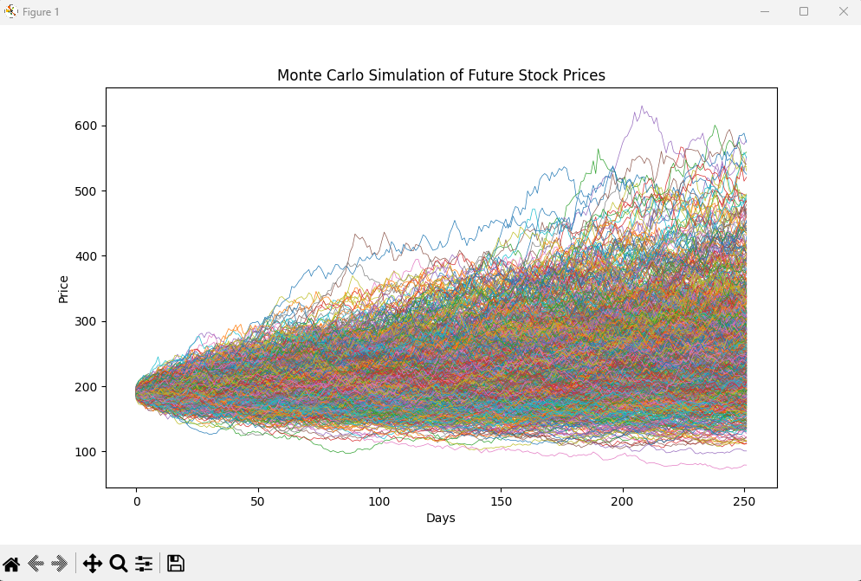
Simulation Output
Key Insights
Fan-Out Pattern
Paths diverge over time — uncertainty grows with the simulation horizon.
Log-Normal Dist.
Final prices follow a log-normal distribution driven by accumulated returns.
Fat Tails
Extreme outcomes (crash / moonshot) are rare but visible in the outer paths.

Slide 9
Strategy Evaluation
Buy & Hold
Moving Average
Stop Loss
Highest Returns
Balanced Risk
Capital Protection
Strengths
Strengths
Strengths
Simplest strategy to execute
Filters market noise effectively
Limits maximum loss per trade
Captures full upside in bull markets
Reduces exposure during downturns
Automatic exit reduces emotion
Highest average profit in simulations
Moderate risk-return profile
Significantly reduces worst-case losses
– No downside protection
– Lagging indicator — late signals
– Lower average total returns
– Exposed to full drawdown risk
– May miss early-stage rallies
– May exit prematurely in volatile markets

Slide 10
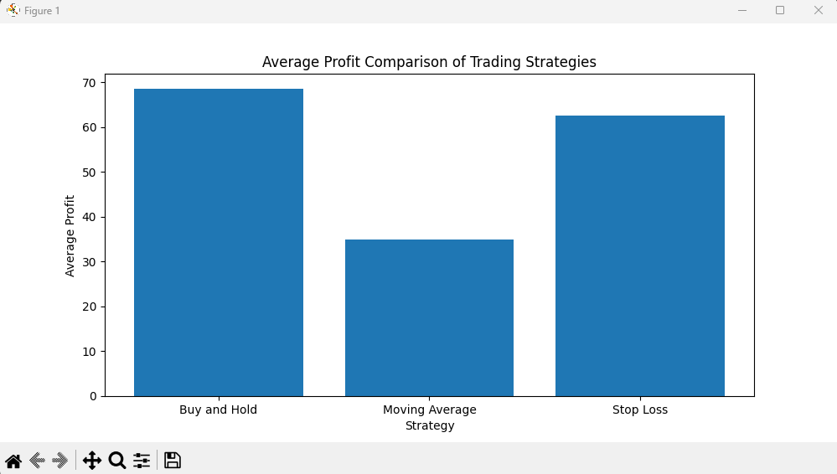
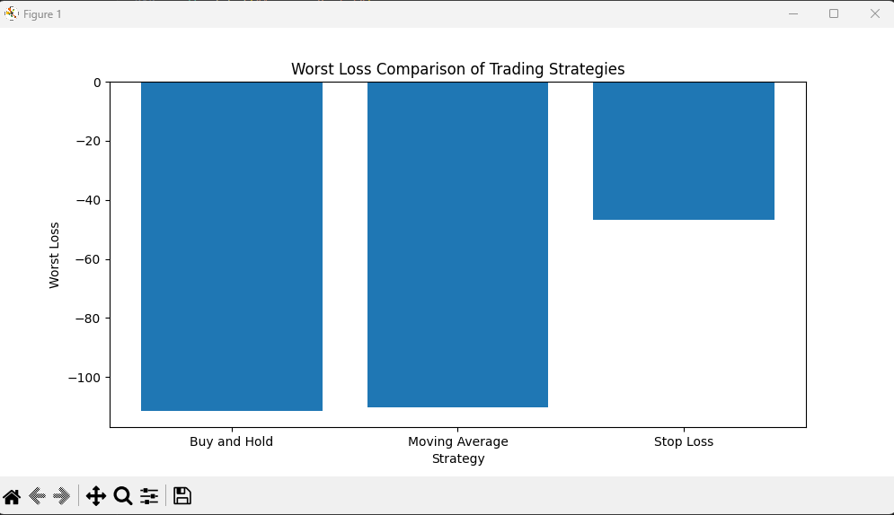
Strategy Comparison
Key Finding · Buy & Hold maximises returns but accepts full drawdown risk · Stop Loss trades profit for safety · Moving Average balances both

Slide 11




Challenges Encountered
01
02
Handling Real Market Data
Randomness Consistency
Yahoo Finance data contained missing values, corporate split adjustments, and inconsistent date ranges — requiring dedicated preprocessing and validation pipelines.
Ensuring reproducibility across simulation runs while maintaining true stochastic behaviour required careful random-seed management and distribution validation.
03
04
Strategy Implementation
Debugging Simulations
Translating financial strategy rules (crossovers, stop thresholds) into clean, vectorised simulation logic without introducing look-ahead bias.
Standard deterministic debugging techniques fail with stochastic code — outputs differ each run, making defect isolation significantly more challenging.

Slide 12
Conclusion
Future Work
Monte Carlo simulation effectively quantifies stock market uncertainty at scale
GBM Extension
Full Geometric Brownian Motion with continuous-time drift and diffusion
1,000 simulated paths produce stable, reliable statistical distributions
ML Integration
LSTM / transformer models to predict μ and σ dynamically each day
Stop Loss strategy demonstrably reduces worst-case portfolio losses
Portfolio Simulation
Multi-asset portfolios with correlation matrices and auto-rebalancing
Buy & Hold consistently outperforms when market trend is broadly positive
Expanded Universe
Full S&P 500 sector analysis beyond the initial four test stocks

Slide 13
Thank You
Questions & Discussion Welcome
Shivam Patel · Saumya Pandya · Rushi Rathod
SOFE 4820U — Modelling & Simulation

